Slide 1
Building Bridges to Housing: AddrressING Homelessness in Nevada County
Brendan Phillips, MSW Housing Resource Manager, Nevada County
Mike Dent, Director of Housing and Community Services, Nevada County
Joe Naake, Outreach Supervisor,
Hospitality House Shelter
Valentina De La Fuente
SOARWorks Coordinator, FREED

Slide 2
The 2019 Homeless Point In TimE Count
Mandated by the Department of Housing and Urban Development
Subject to lots of variables
Good for measuring broad trends but not accurate
A good rule of thumb is to double the count

Slide 3
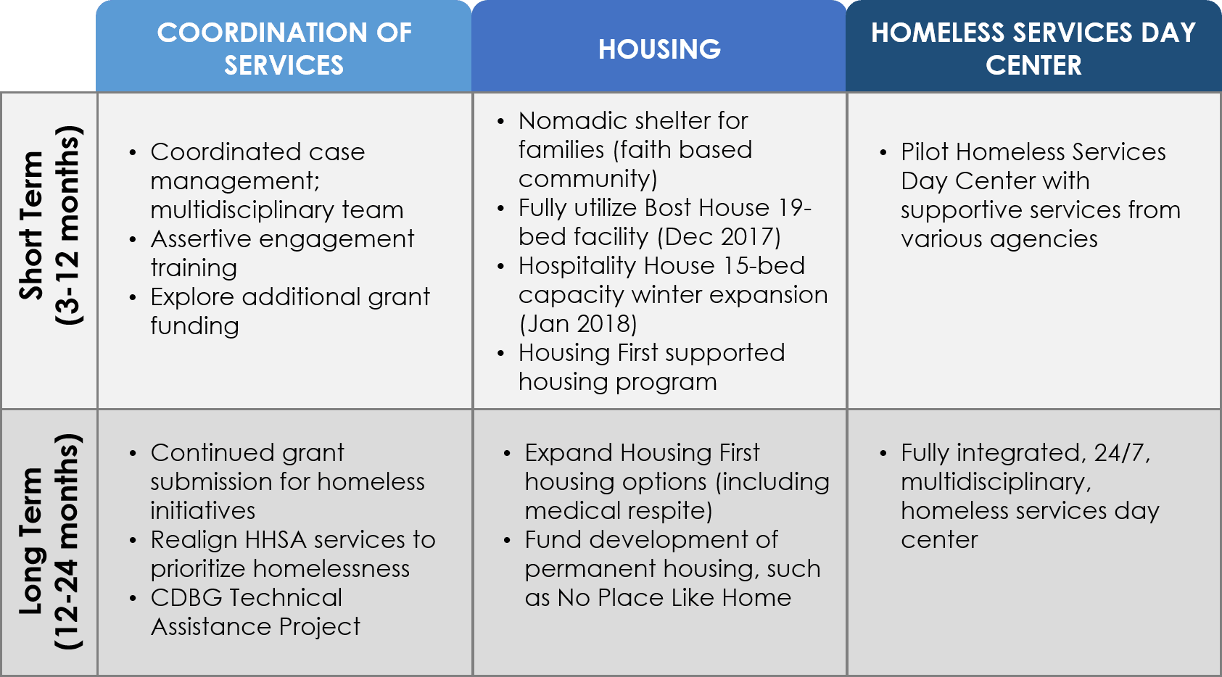
NEVADA COUNTY Initiatives:
Our Vision
All individuals and families facing homelessness in Nevada County will have access to safe, permanent, affordable housing, supported by the resources and services necessary to sustain them.
Notes:
The board priority for 2019 looks a little different than what it looked like in 2018. In 2018 it was one big priority and now it divides the priority between homeless services and housing. in 2017, HHSA staff worked to put together a frame work for implementing the Boards priority, “Better Together:
Coordination of Services
Housing First Pilot Project
Homeless Day Services/Navigation Center
(see above)

Slide 4
The 2018 NeVADA County Board Priority
In partnership with community providers and other jurisdictions, build an expanded system of coordinated care, outreach, transitional and permanent housing, and supportive services to address the needs of the homeless population and to mitigate impacts on the community.
Coordinate with local jurisdictions, developers and other partners to maximize leveraging opportunities with new state funding for affordable and workforce housing development.

Slide 5
Progress To Date:
EXPANDING SERVICES:
Implemented the Homeless Outreach and Medical Engagement (HOME) team
Coordinated multi-disciplinary case conferencing teams (HOT and the HRT)
Expanded embedded case management at multiple agencies and institutions

Slide 6
Progress To Date:
EXPANDING SHELTER:
Expanded shelter capacity, lowered barriers to access
Implemented Recuperative Care at the Shelter
Strengthened Extreme Weather Shelters

Slide 7
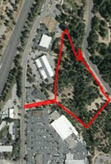
Progress To Date:
EXPANDED HOUSING OPPORTUNITIES
Implemented Bridges 2 Housing – Low barrier, Housing First Pilot
Awarded No Place Like Home, funding for a 40-unit low income housing development
Landlord Recruitment and Retention
Lone Oak, Truckee Lofts and Courtyards

Slide 8
Progress To Date:
INCREASED COLLABORATION:
Increased Continuum of Care participation
Fully Implemented Coordinated Entry
Partnered with nonprofits, cities and other stakeholders

Slide 9
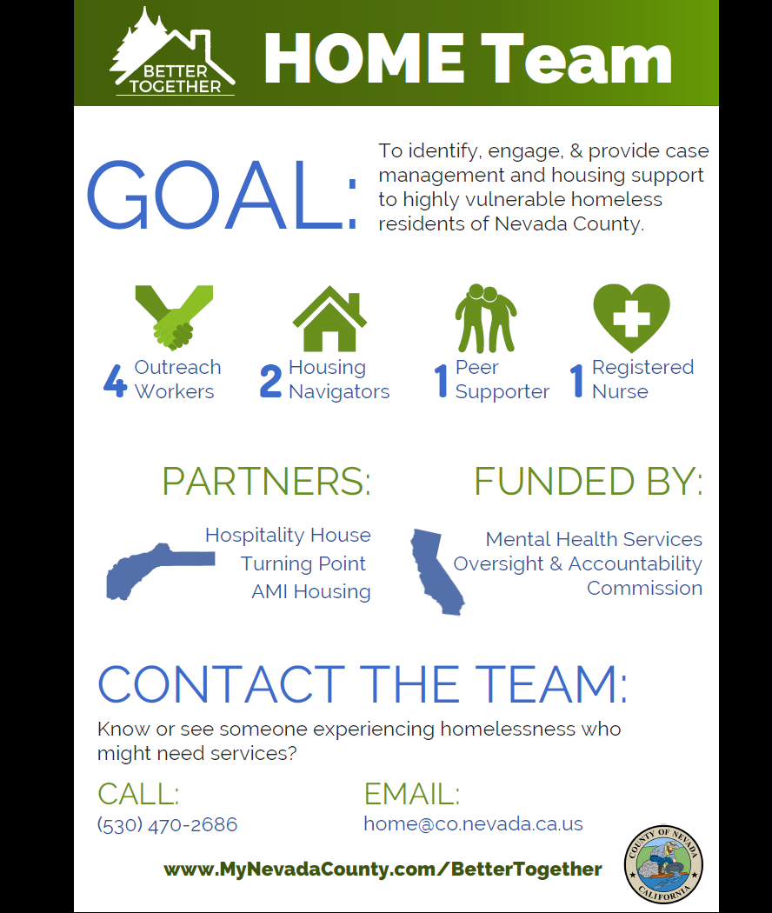
The Homeless Outreach Medical Engagement Team
Notes:
Insert HOME team Inforgraphic

Slide 10
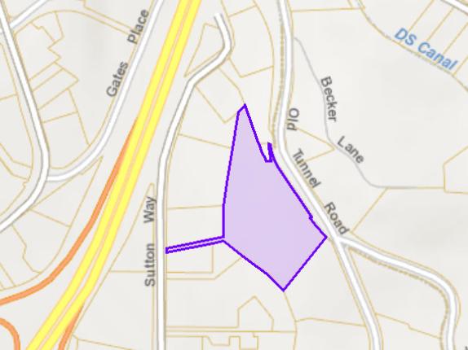
Housing
Affordable Housing Development:
Truckee Artist Lofts Project Currently Under Construction
77 Unit Multi-Family Affordable Housing Project
Lone Oak Apartments Received TCAC Funding on Sept. 25th
31 Unit Senior Affordable housing Project in Penn Valley
Brunswick Commons Cleared Entitlement Process
Courtyard Apartments Refinanced With Assistance of County
Notes:
Brunswick Commons, Lone Oak, Lofts etc

Slide 11
FREED’s mission is to promote independence and self-determination for people with disabilities through person-driven services, collaborative community partnerships and education, and leadership that advocates for fully inclusive communities
Housing and Advocacy Disability Program (HDAP)
To assist disabled individuals who are experiencing homelessness apply for disability benefit programs while also providing housing assistance. HDAP has four core requirements: outreach, case management, disability advocacy, and housing assistance.
Through HDAP, FREED has served 42 homeless individuals with housing financial assistance since its start in June 2018
To Date, 12 individuals approved for disability benefits

Slide 12
Questions?
Notes:
HDAP

