Slide 1

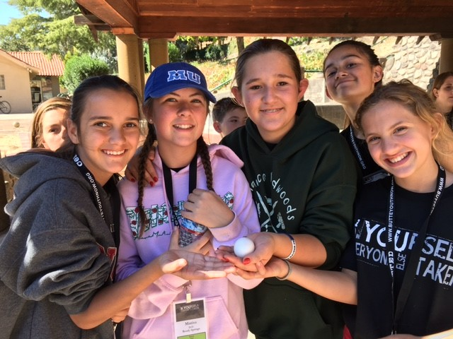
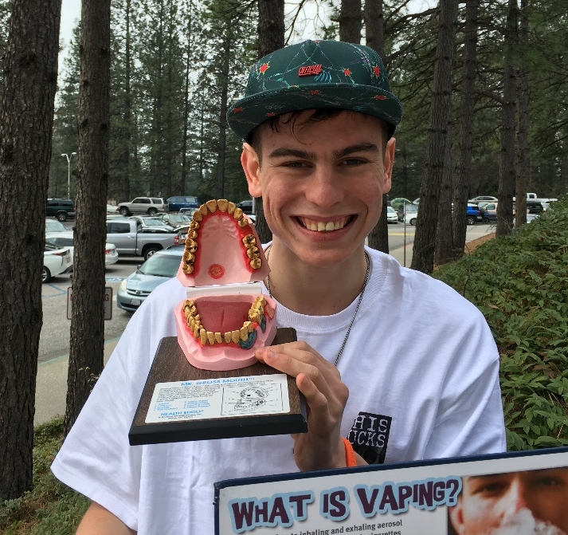
What is TUPE?

Slide 2
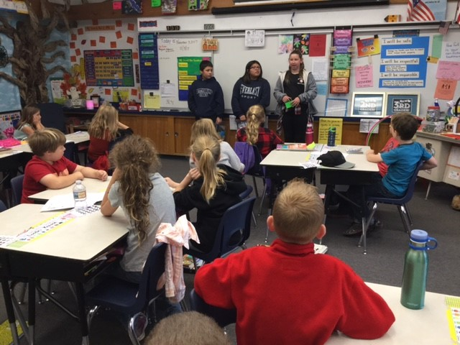
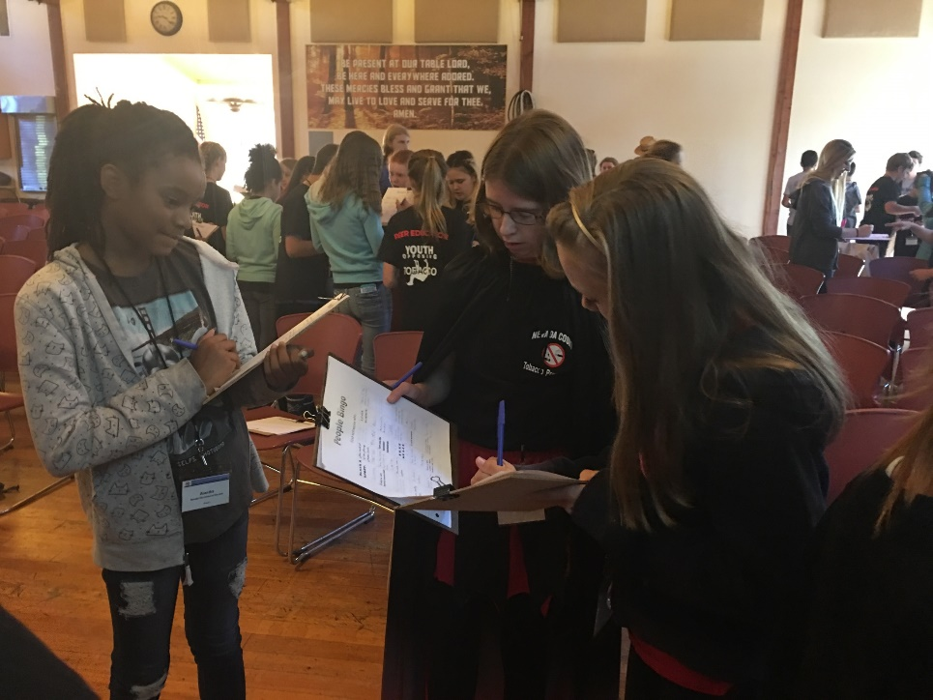
TUPE Brings Tobacco Prevention Education and Youth Advocacy to Nevada County Schools

Slide 3
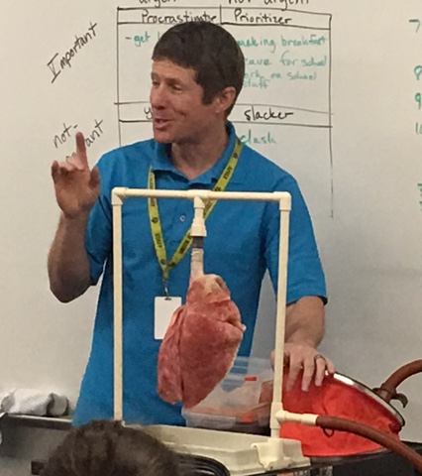
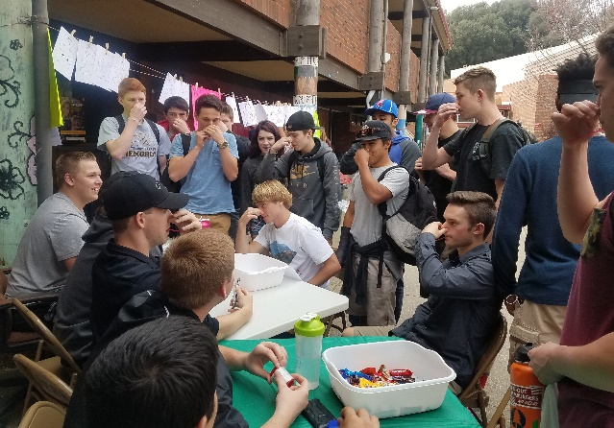
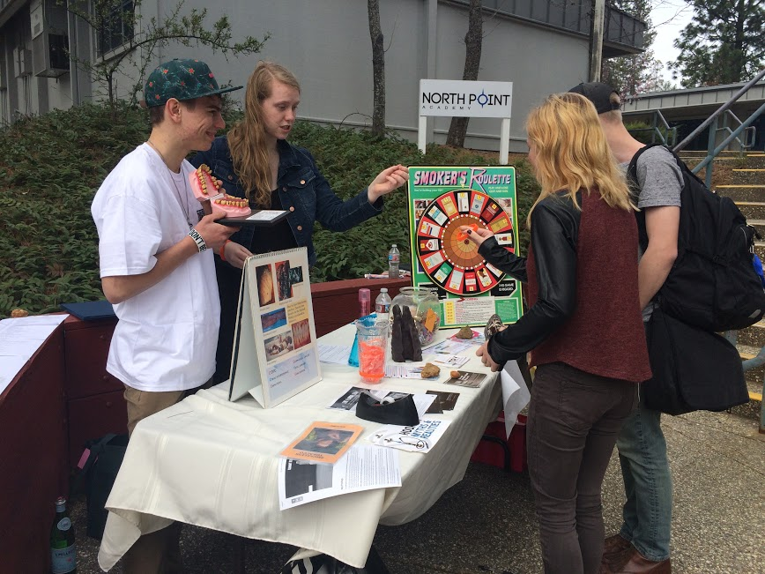

TUPE Site Coordinators Oversee:
Classroom Curriculum
Peer Educator Groups
School and County-Wide Events
Extra support for At-Risk students
Parent Education

Slide 4
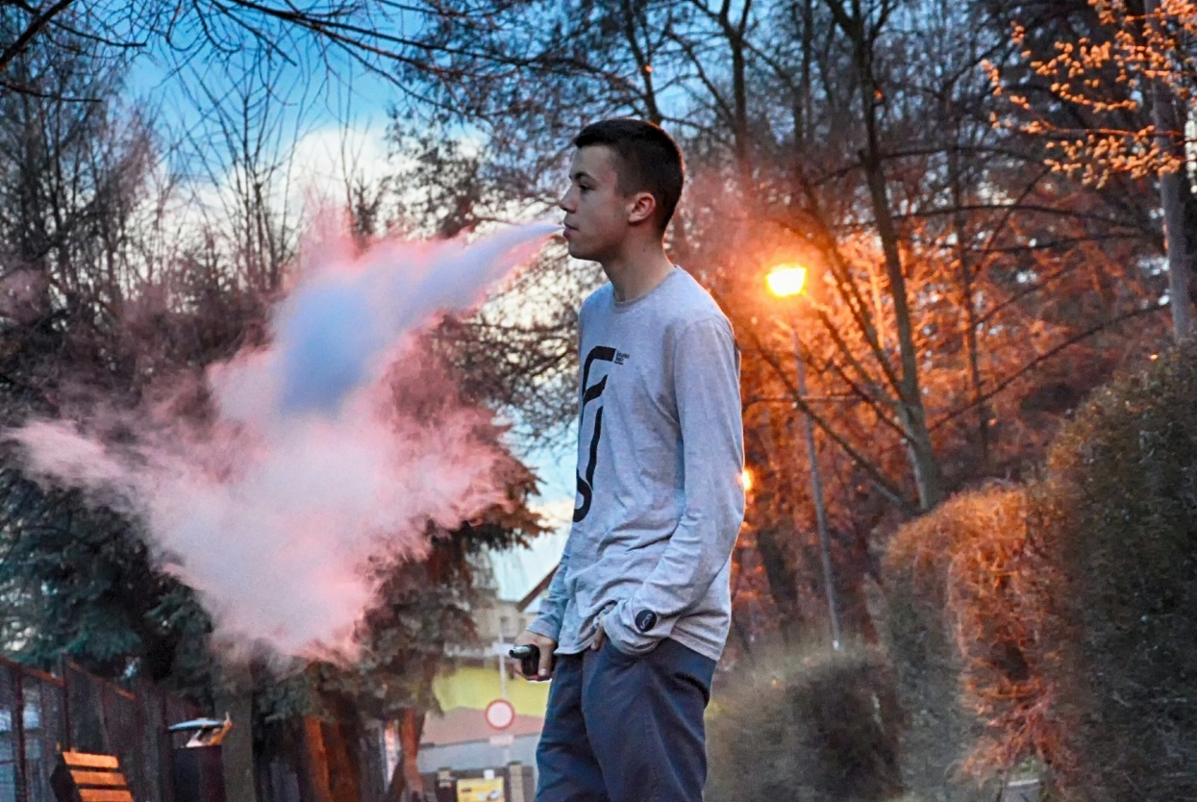
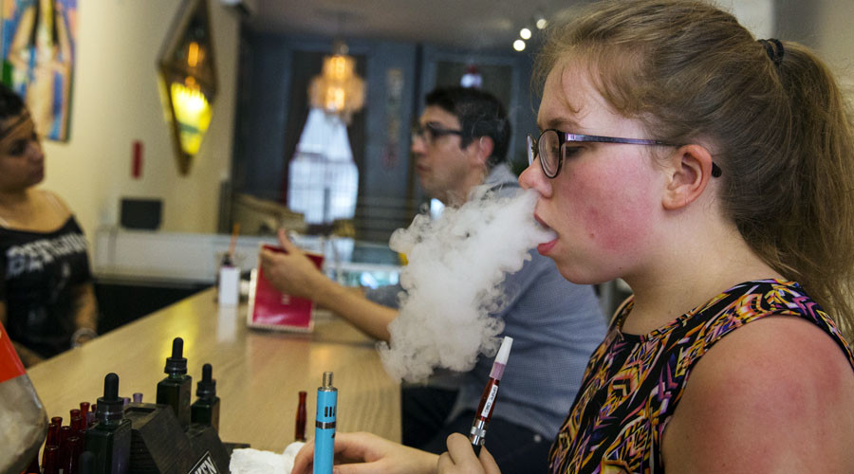
What do you know about vaping?

Slide 5
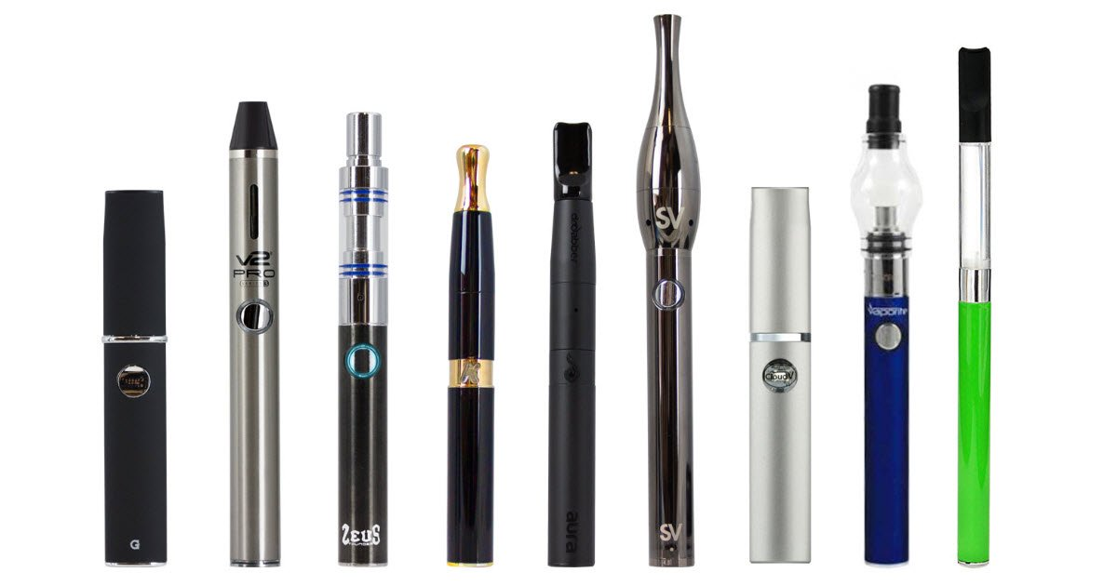
How many of you vaped as teens?

Slide 6
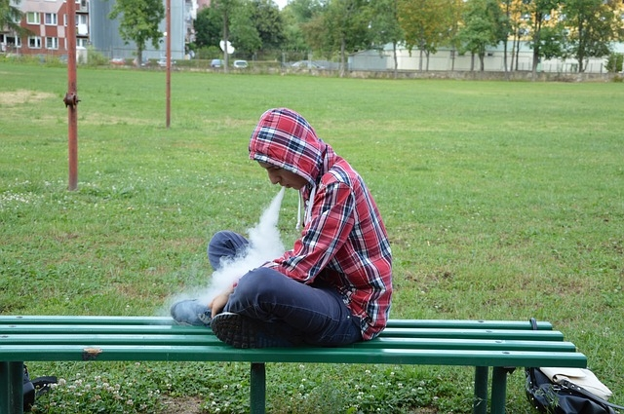
Why were vape pens created?

Slide 7
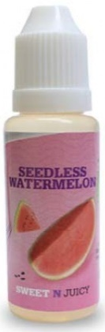
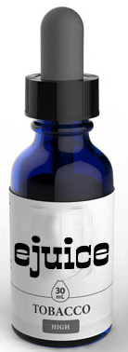
How they work
Atomizer/coil
Battery
Nicotine aerosol
Absorbent material/cotton to soak up E-JUICE
Notes:
Huge increase in E-Cigs and Vaping.
Teacher Talking Points:
Click: E-cigarettes are made of a battery, (click) an atomizer with a heating coil, (click) and an absorbent material that absorbs a liquid (click) that can contain nicotine, flavoring and chemicals.
The battery allows the atomizer to heat the liquid, called e-juice, which creates an aerosol that is breathed into the lungs and breathed out into the air repeatedly.
Some of these devices are pre-loaded with the e-juice that comes in bottles like these (click) and others where the users add it themselves.
The original e-cigarettes looked like a cigarette, came pre-loaded and were disposable.

Slide 8
E-Juice has nicotine and many other unhealthy chemicals
Propylene glycol
→Antifreeze
Ethylbenzene
Acetone
→Nail Polish Remover
→Paints, Pesticides
Nicotine
→Cigarettes
Rubidium
→Fireworks
Formaldehyde
→Embalming
Notes:
Teacher Talking Points:
Although the chemicals that have been found in e-cig aerosols might seem unrecognizable, you are familiar with other places some of those same chemicals can be found.
(click) For example, Propylene glycol can be found in antifreeze products or also used to winterize plumbing systems
(click) Acetone is commonly found in nail polish remover and as a paint thinner
(click) Ethylbenzene is often used to make other chemicals. It’s also found in other products, including pesticides, synthetic rubber, varnishes paints, and inks
(click) Formaldehyde based solutions are also used in embalming to disinfect and temporarily preserve human and animal remains
(click) Maybe the most important ingredient here is nicotine. Nicotine is a drug that's highly addictive in moderate doses, and is the reason why smokers smoke even after they start getting sick. Of course, in high doses, it's a poison--in fact, plants make it to keep insects from eating them. It's a funny drug that has a lot of effects, but mostly it's an upper.
(click) Rubidium is a chemical that can be used to give fireworks their bright colors
So now that you know that e-cigarettes/vape pens produce aerosol, and that those aerosols contain harmful chemicals, how would you describe e-cig clouds to someone who says they are just water vapor?

Slide 9
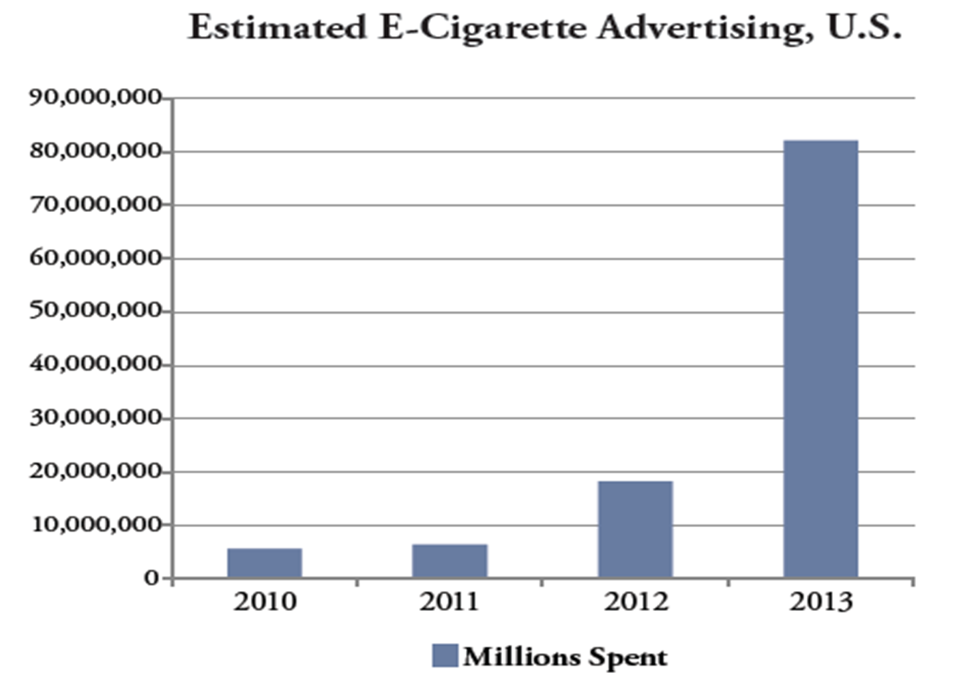

Slide 10

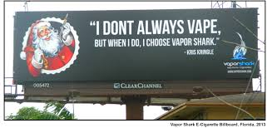
Advertising

Slide 11

DO MOST TEENS USE MARIJUANA?

Slide 12
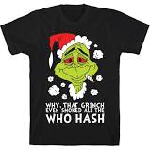
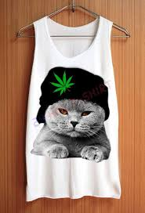
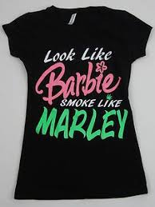
MARIJUANA CULTURE HAS CHANGED

Slide 13
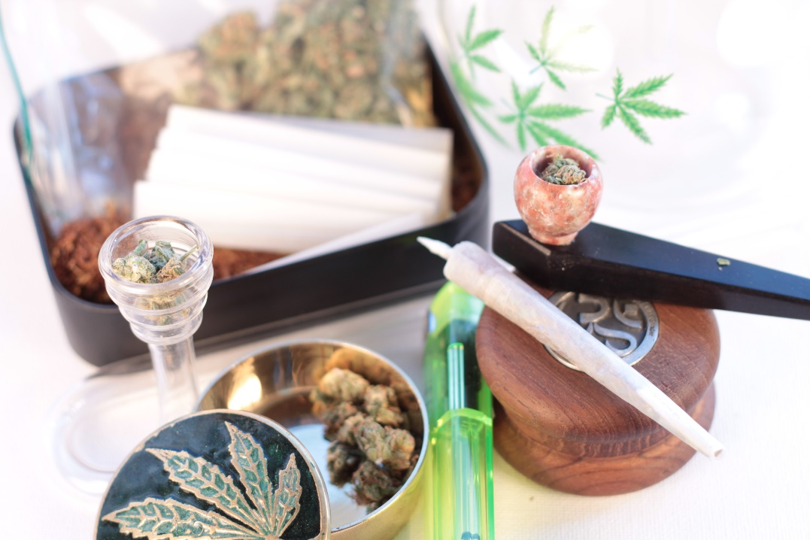
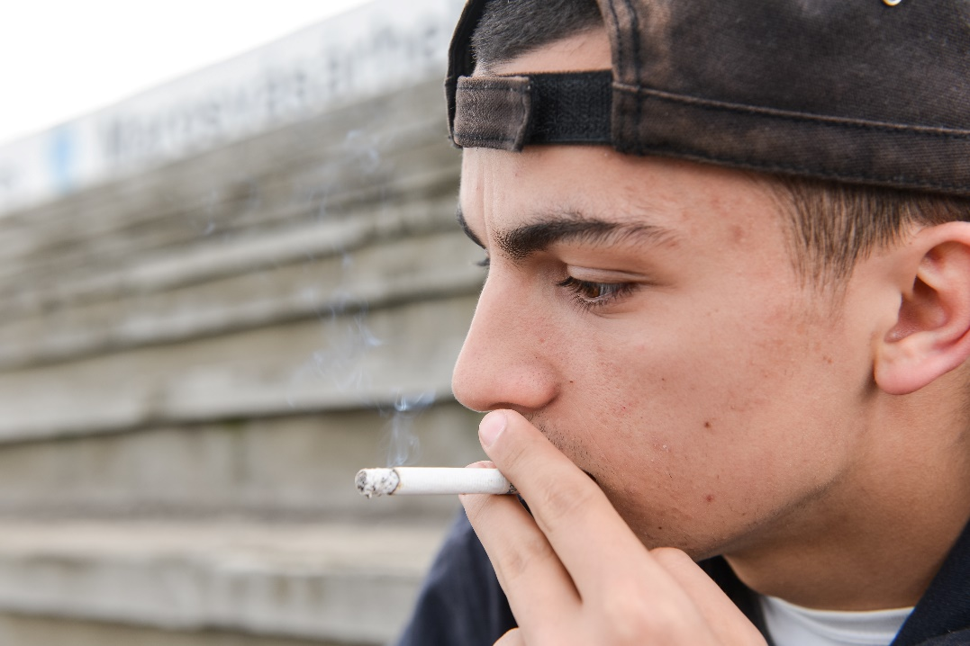
IT CAN BE SMOKED
Notes:
It’s natural
No big deal: 8 out of 10 teens do not believe monthly cannabis use is risky.
Legal
Medical

Slide 14
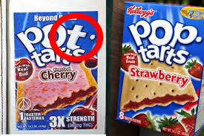
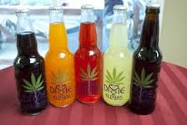
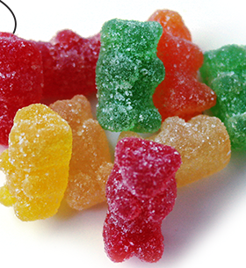
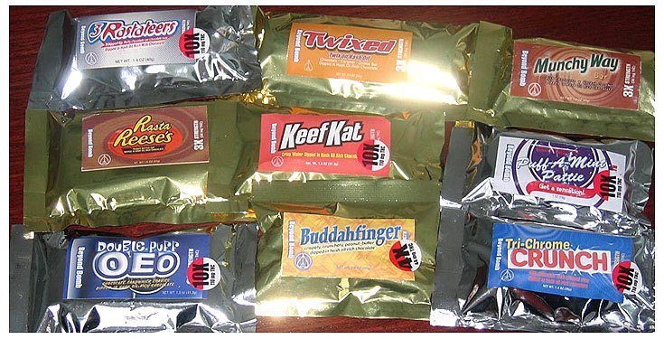
IT CAN BE EATEN
Notes:
Pot brownies a thing of the past
Very high concentration
Increase in ER visits: since legalization of marijuana in Colorado, child admissions to emergency rooms and
poison control have increased significantly.
Marijuana-infused edible products were responsible for 52% of those admissions. The average age of those children was
two years old.

Slide 15
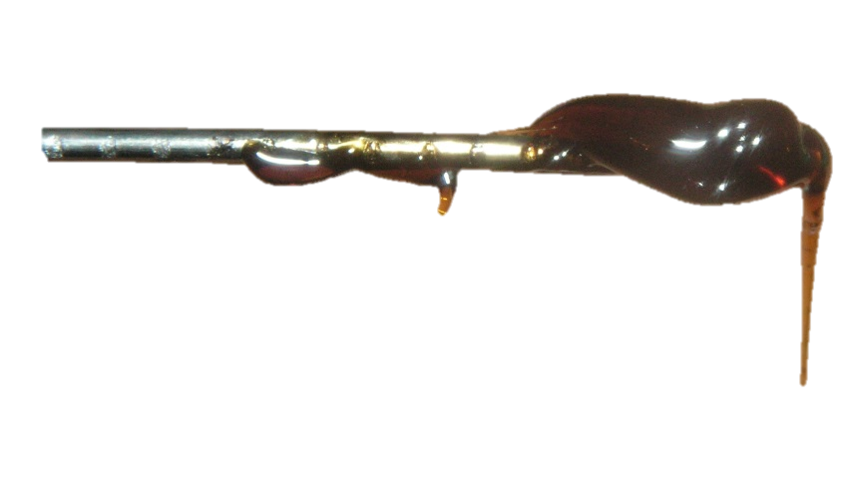
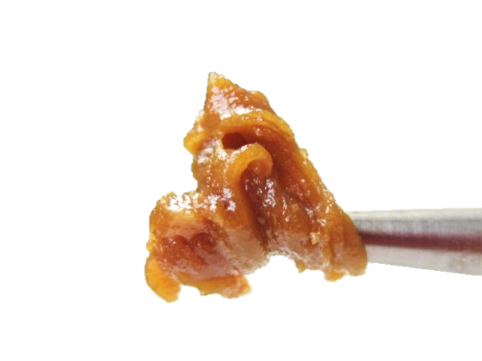
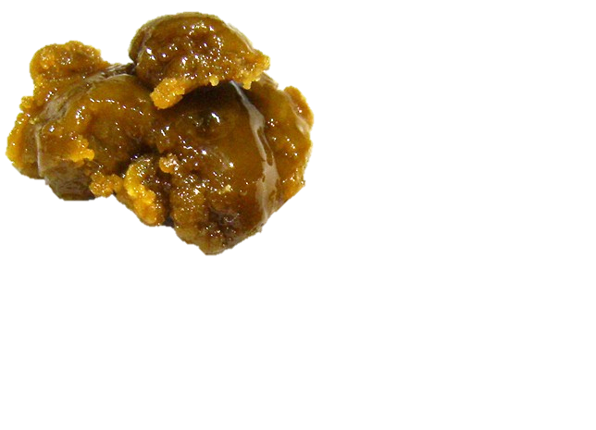
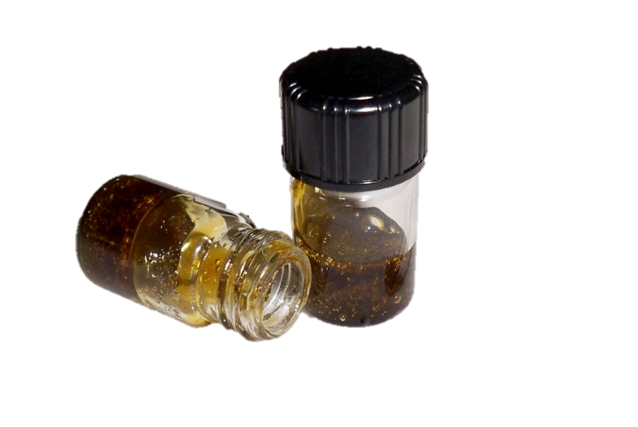
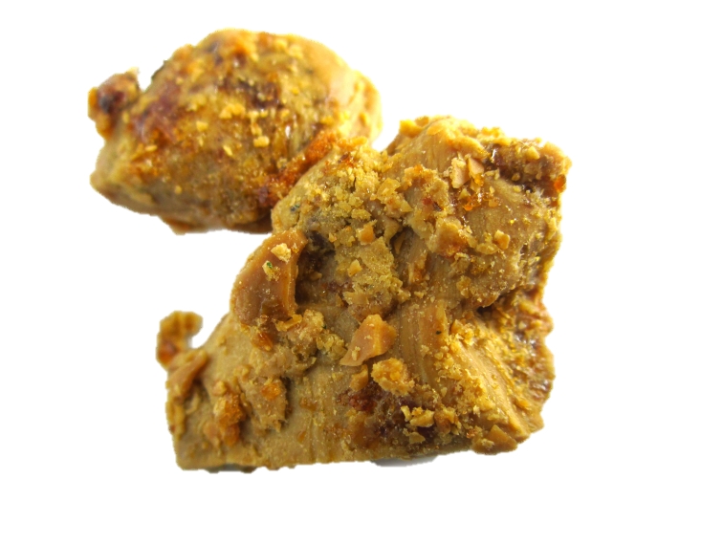
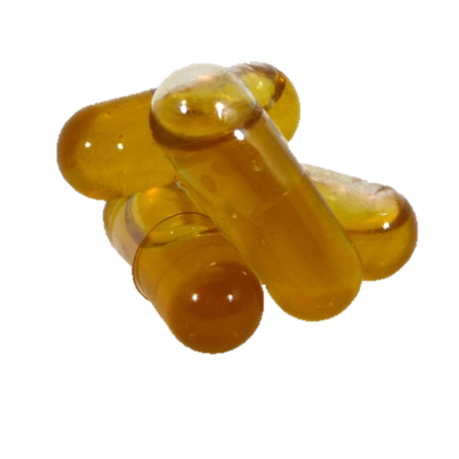
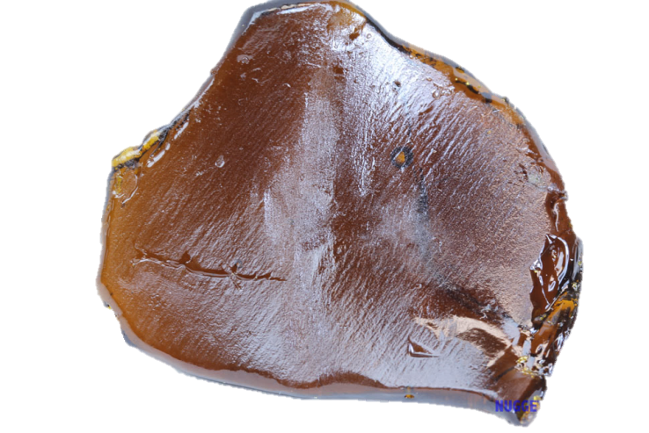
IT CAN BE VAPED:
CONCENTRATES
“Green Crack” wax
“Ear Wax”
Butane Hash Oil (BHO)
Hash Oil Capsules
“Budder”
“Shatter”
Notes:
BHO is also known as...
Dabs
Budder
Shatter
Wax
Used by heating up the concentrate and smoking the “vape”

Slide 16

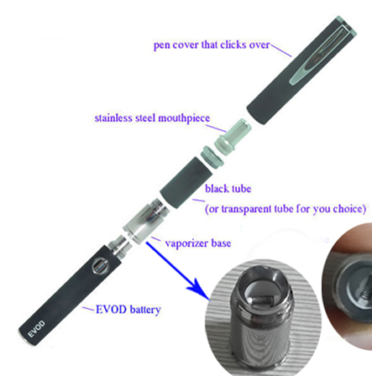

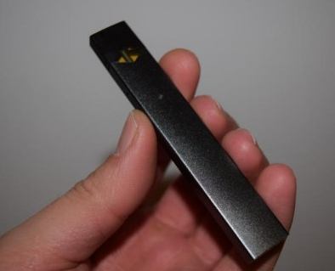
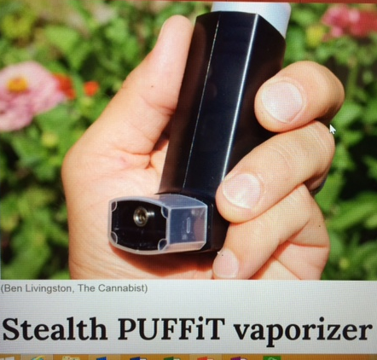
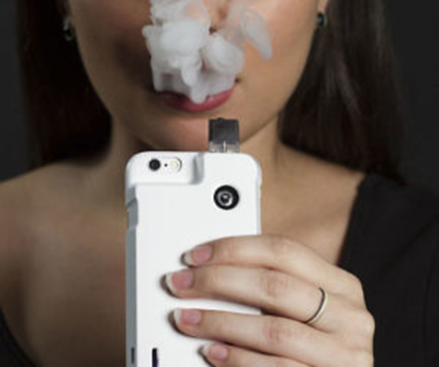
STEALTH DEVICES
Notes:
Shelley

Slide 17
THC:
Psychoactive Ingredient
Notes:
THC-Tetrahydrocannobinol (psychoactive ingredient)
CBD-Cannabinol is a cannabis compound that has significant medical benefits, but does not make people feel “stoned” and can actually counteract the psychoactivity of THC
THC levels have drastically increased while CBD levels have stayed the same

Slide 18
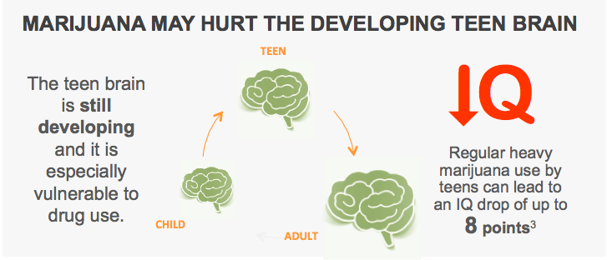
Notes:
May be permanent

Slide 19
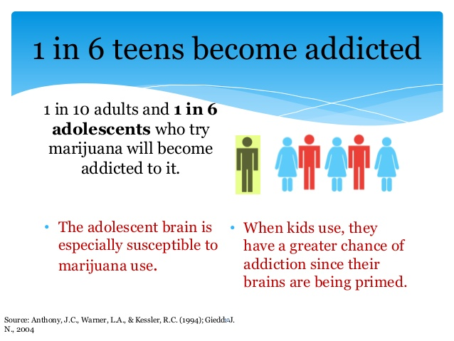
Notes:
Now listed in the DSM 5

Slide 20
