Slide 1
California Children’s Services
Caring for Children with Special Medical Needs

Slide 2
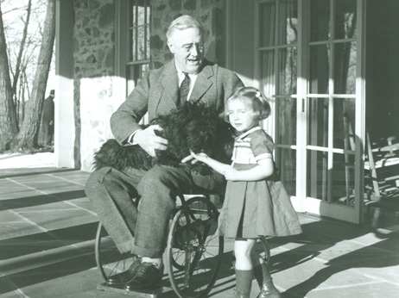
The CCS Story
1927: Polio Epidemic
  Crippled Children’s Services
1935: Roosevelt’s “New Deal”
  Established Maternal & Child Welfare State Grants
1945: Medical Therapy Program (MTP) established
  Children with orthopedic impairments associated with cerebral palsy

Slide 3
The CCS Story (cont.):
1961: Budget Act
  Expanded MTP eligibility for children with various other neuromuscular and musculoskeletal conditions
1965: Lyndon Johnson’s “Great Society”
  Extended medical benefits to all children in low-income households
1968: Robert Crown Act
  Established county responsibility for administering the MTP
Shift Over Time:
  More conditions that are chronic and less preventable in nature have been made eligible for the CCS program. Examples include bone anchored hearing aids, cystic fibrosis care and treatment, and advances in diabetic care such as insulin pumps.

Slide 4

CCS Today
Partnership between County Health Departments & the California Department of Health Care Services (DHCS)

Slide 5
Legislative Authority
Mandated by the Welfare & Institutions Code and the California Code of Regulations (Title 22, Section 51013)
The intent of the law is to provide necessary medical services for children with CCS eligible medical conditions

Slide 6
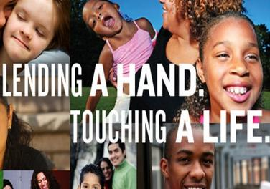
What is California Children’s Services (CCS)?
Statewide Program that provides funding for treatment of children with certain physical limitations and chronic health conditions or diseases.
Arranges, directs, and pays for medical care, equipment, and rehabilitation when these services are authorized by the program and the child is eligible for services.

Slide 7
CCS Eligibility
Under 21 years of age.
Permanent residence of the California county in which you apply.
Adjusted family gross income of <40,000/year OR if the child’s medical cost the family more than 20% of the family’s yearly income.
No income requirement if a child was adopted with a CCS eligible condition at the time of adoption.
Eligible medical condition.

Slide 8
Medical Eligibility
CCS does not cover ALL medical conditions
Generally covers medical conditions which are:
  Physically disabling
  Need to be treated with medications, surgery, or rehabilitation

Slide 9
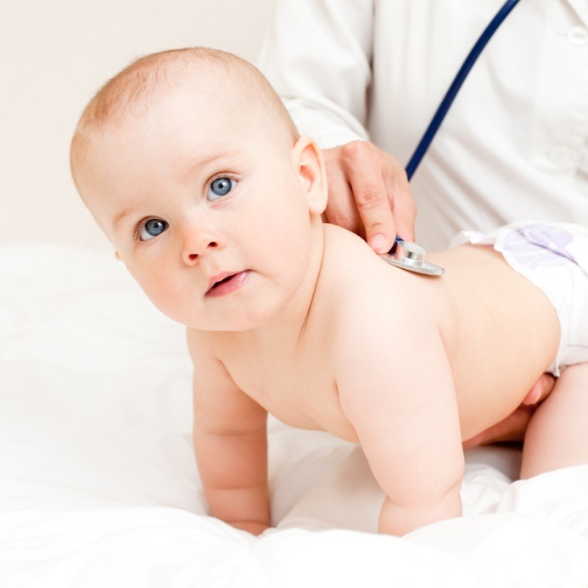
Examples of CCS Eligible Medical Conditions
Heart conditions
  Congenital heart disease
Cancer/tumors
Diseases of the respiratory system
    Cystic Fibrosis, chronic lung disease
Disorders of the various major organs
  Kidneys, Endocrine, Liver, Gastrointestinal System

Slide 10
Examples (cont.)
Serious birth defects
  Cleft lip/palate, spina bifida
Diseases of the neurological and musculoskeletal systems
  Cerebral palsy, uncontrolled epilepsy, seizure
Immune system disorders
Complications of premature birth
Disabling injuries & poisonings
  Severe brain or spinal cord injuries
  Severe burns

Slide 11

Diagnostic Services
Potential CCS clients who need additional studies or tests for a confirming diagnosis
CCS case will be opened to confirm the presence or absence of a CCS qualifying diagnosis.

Slide 12

Treatment
Doctor Services
Hospital & surgical care
Physical therapy (PT)
Occupational therapy (OT)
Laboratory tests/Radiographic studies
Orthopedic appliances & medical equipment
Referrals
  Public health nursing, regional centers

Slide 13
Medical Case Management
Medical case management is done by the CCS PHN Case Manager. Case management can help access specialty care when medically necessary, and make referrals to other agencies, including public health nursing and regional centers
  Alta California Regional Center
  Family Voices
  WarmLine Family Resource Center

Slide 14

CCS Medical Therapy Program (MTP)
The MTP is a special program within CCS that provides physical, occupational, and medical therapy conference services for children who have handicapping conditions generally due to neurological or musculoskeletal disorders.

Slide 15
CCS Mission Statement
“Our mission is to collaborate with the child and family to maximize the child’s functional independence with life skills”

Slide 16
Medical Direction
Physician oversight for the MTP eligible condition is provided by:
  Medical Therapy Conference (MTC)
  Paneled and approved CCS private Physicians
  Special Care Centers (SCC) that have specialty teams for a particular condition
    MTP services require a prescription/therapy plan from one of these sources

Slide 17
Medical Therapy Unit (MTU) Conference
Team management approach
  Review diagnosis
  Nutrition and/or medication(s)
  Assessment of therapy needs (physical/occupational therapy)
  Equipment recommendations
  Referral/assistance with other resources

Slide 18
MTU Referrals
Referrals can be made by anyone
  Hospital and clinic personnel, parents, teachers etc.
CCS will determine if the condition is medically eligible.
The MTU will evaluate and provide follow-up based on an individual basis.

Slide 19
MTU Therapists
Evaluations
  Every 6-12 months
  Establish functional goals which reflect the child’s ability to access/perform basic mobility and self care activities
Treatment
  Based on individual needs
Equipment
  Braces and/or durable medical equipment

Slide 20
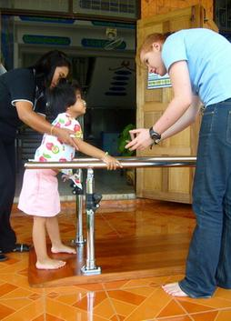
Physical Therapy Consists of:
Ambulation
Mobility
Transfers

Slide 21

Occupational Therapy Consists of:
Self Care:
  Hygiene
  Dressing
  Eating
  Grooming
  Toileting
  Oral-motor

Slide 22

Questions/Discussion

Slide 23
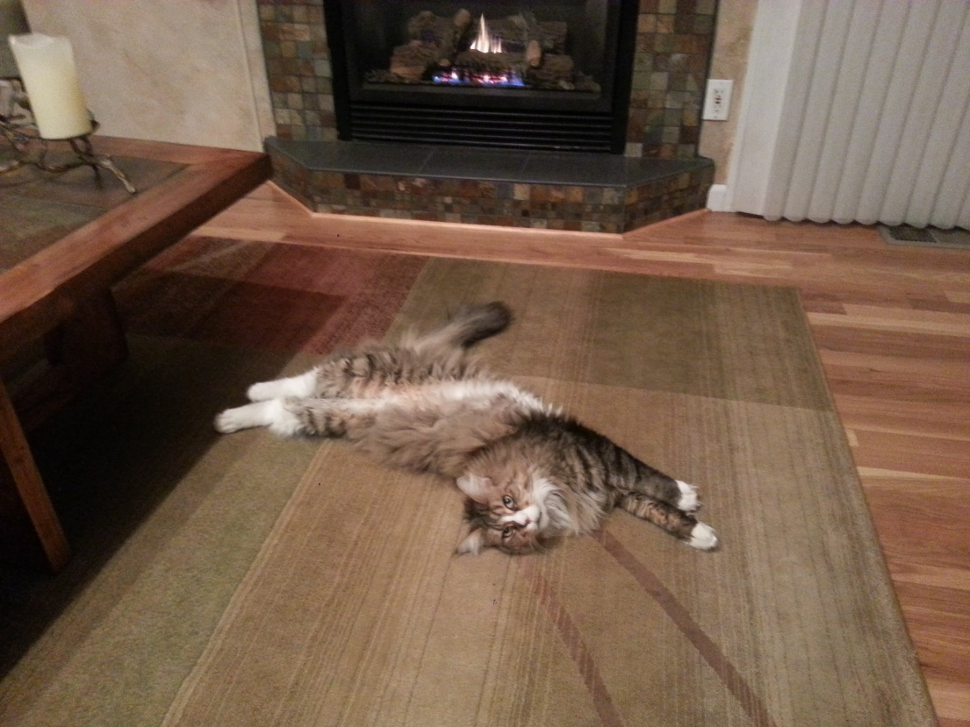
The End

