Slide 1
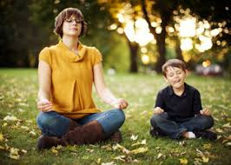
Being of Service, Mindfully
Mindfulness in the helping professions
A presentation for the
Community Support Network
of Nevada County
By Rachel Peña Roos, LCSW
January 7, 2015
Notes:
Start with an introduction of myself and the assertion that I am no expert. I will outline the reasons why I think it is worth looking into and provide resources for guests to do their own research and start their own practices. Then we will have the opportunity to experience a few mindfulness exercises to make this more of a visceral experience of being present in your body, now.

Slide 2
What is Mindfulness?
mind·ful·ness
/mīn(d)f(ə)lnəs/
noun
the quality or state of being conscious or aware of something.
a mental state achieved by focusing one's awareness on the present moment, while calmly acknowledging and accepting one's feelings, thoughts, and bodily sensations, used as a therapeutic technique.

Slide 3
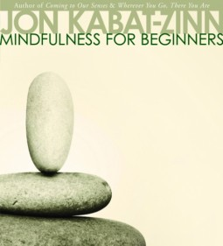
Jon Kabat-Zinn
a well-known teacher of mindfulness meditation and the founder of the Mindfulness-Based Stress Reduction program at the University of Massachusetts Medical Center.
“Mindfulness means paying attention in a particular way; On purpose, in the present moment, and nonjudgmentally.”

Slide 4
What Mindfulness is NOT
Religious
About “being calm”
Absence of thought
About discipline
A Silver Bullet

Slide 5
Mindfulness and Meditation
Associations with the word “Meditation”
Religious
Eastern/exotic/foreign
Mantras
Visualization

Slide 6
Mindfulness and Meditation
Useful Associations of mindfulness
Sensory experience
Awareness training
Daily activities and practice
GOALS: Self-awareness, balance, impulse control, focus
Notes:
Good transition to why it is helpful within the context of therapy.

Slide 7
Mindfulness and Therapy
Mindful Schools
ADHD, impulse control, focus, classroom control
Mindfulness Based Stress Reduction (MBSR)
Anxiety, OCD, Addiction, Depression
Mindfulness Based Cognitive Therapy (MBCT)
Major Depression

Slide 8
Research Base
52 papers published in 2003
477 published in 2012
American Psychological Association Literature Review-2011
Notes:
The APA review is on the back table or available online if you are interested

Slide 9
Research Findings
Effective Emotional regulation
Impulse Control
Reduction of chronic pain
Decreased Reactivity
Increased Response/Cognitive flexibility
Increased communication and satisfaction in relationships
Notes:
Decreased rumination, decreased depression, anxiety, chronic pain, Self-observation disengages automatic pathways/responses and allows more flexibility.

Slide 10
Research Findings, cont.
Decreased experiences of craving and relapse in addictions
Increased information processing
Enhanced functioning of the pre-frontal cortex
Responsible for insight, morality, intuition, and fear modulation
Notes:
Smoking study in 2010 found a 60% reduction in smoking in those with a 6 week mindfulness practice, even in those who did not intend to quit. Physiological brain changes and chemical changes

Slide 11
Benefits for Care Providers
Increased empathy, compassion and counseling skills
Decreased stress and anxiety
Greater attention, self-regulation
Decreased fatigue
Increased immunoreactivity
Notes:
Comfort with silence, more attuned with yourself and others, more attentive to the therapeutic process. Study showed that medical students and residents who used MBSR had less stress-related cortisol, got less sick, reported feeling happier, had superior attention, etc.

Slide 12
Questions?

Slide 13
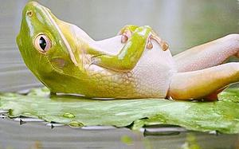
Let’s Practice!

