Slide 1
Cracking the Code of Special Education
Presented by:
Eli Gallup, Director
November 5th, 2014

Slide 2

What is Special Education?
Specially designed instruction, at no cost to the parents, to meet the unique needs of a child with a disability.
Special Education is a service, not a place

Slide 3

The Goals of the SELPA
Deliver high quality special education programs and services to the students with disabilities in the most effective, efficient and cost effective manner practicable.
Foster cooperation within the local districts for coordination between regular and special education
SELPA = Special Education Local Plan Area

Slide 4
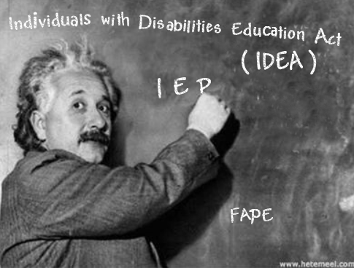
Continuum of services
Maintain programs and service that promote opportunities for individuals with disabilities to achieve at a level commensurate with their ability
Assure inclusion
Assure the availability of due process rights
Encourage parent participation and provide parent education
Assure certificated and classified professional development (Teachers and Instructional Aides)

Slide 5

Foster community support through advocacy
Assure effective management system
Implement cost effective procedures
Maintain lines of communication
Maintain quality regional services
Some responsibilities are met through a network of cooperative agency agreements

Slide 6
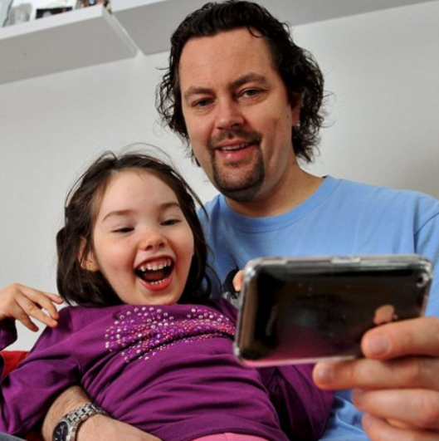

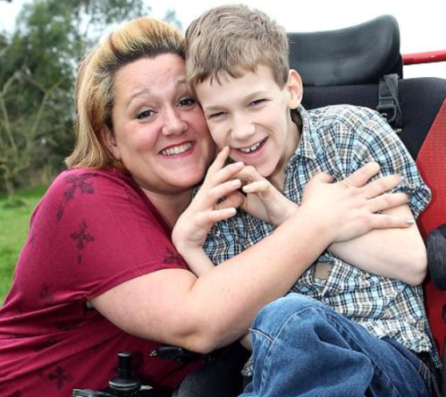

Who do we serve?

Slide 7
Nevada County Special Education by Disability

Slide 8
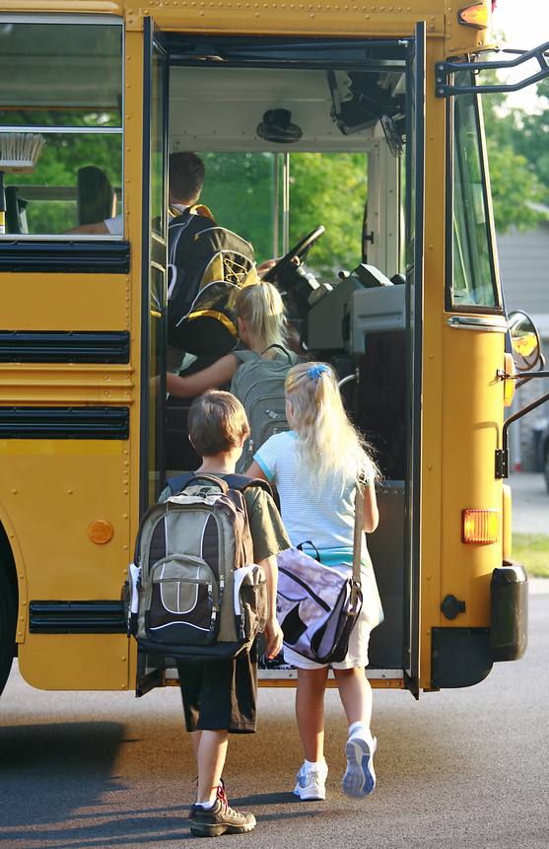
Student Data
Decline in special education count
  Speech & Language Impaired
  Specific Learning Disabilities
Increase in Severely Handicapped Disabilities
  Autism
  Hard of Hearing
  Emotional Disturbance

Slide 9

How to get help IN Schools

Slide 10
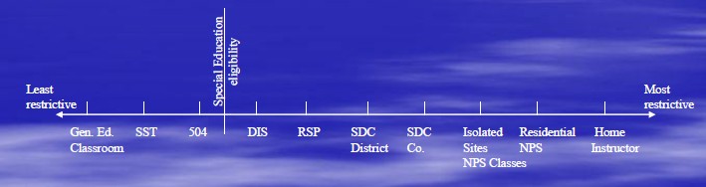
Educational Continuum
IDEA Section 300.114(a)(2)(i) and Section 300-115(a) tell us: To the maximum extent appropriate, children with disabilities are educated with children who are not disabled. Each public agency shall ensure that a continuum of alternative services placement is available.

Slide 11
Special Education Referral Procedure

Slide 12
INDIVIDUALS WITH DISABILITIES ACT (IDEA) 2004
Students with disabilities have a right to a Free Appropriate Public Education (FAPE)….
•In the Least Restrictive Environment (LRE)
•As described in the IEP designed to provide “educational benefit”

Slide 13
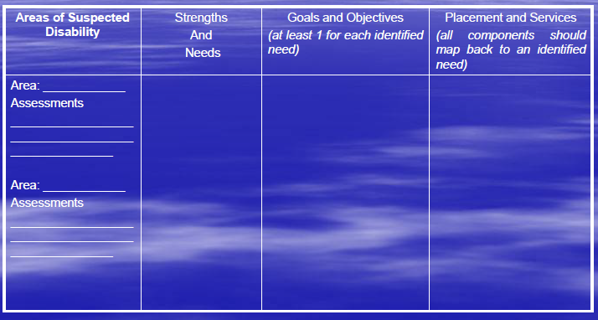
Educational Benefit Chart

Slide 14
Cycle of Special Education
Reason for
Concern / Dx
Review IEP
annually, or
if requested
Request
Assessment
Implementation
Parents submit signed Assessment Plan
Appropriate
Placement:
determined
“PLOP”, Goals, Individualized
Instruction
and Services:
determined
Assessment:
60 days to complete
IEP Meeting:
within the 60 days

Slide 15
Who is eligible?
Between the ages of 3 –22
Two Pronged Test:
1. Meets the definition of an individual with a disability
2. Disability must:
- adversely affect educational performance
- require special education

Slide 16
Special Education Categories
Autism
Deaf
Deaf Blind
Emotionally Disturbed
Hard of Hearing
Mental Retardation
Multi-handicapped
Visually Handicapped
Orthopedically Handicapped
Other Health Impaired
Specific Learning Disability
Speech Impaired
Traumatic Brain Injury

Slide 17
The IEP includes:
Present level of functioning
Measurable annual goals and short term objectives
Statement of specific modifications, accommodations, special education services, related services, supplementary aids and services to be provided
Explanation of the extent to which the student will participate in general education
Statement regarding participation in State and District wide assessments
Projected date for beginning services
Evaluation procedures for measuring progress on goals and objectives.

Slide 18
IEP components continued:
Statement of how child’s parents will be regularly informed of progress
Prevocational/employment/ career education goals, if appropriate
Alternative criteria for promotion
Graduation, if appropriate
A plan for transition into general education
Specialized services and equipment, if appropriate
Transportation needs
Goals for learning English, for students identified as English Language Learners
Extended school year, if appropriate
(Education Code 56345)

Slide 19
IEP
(Individual Education Program)
GOALS &
OBJECTIVES

Slide 20
IEP GOAL REQUIREMENTS
A statement of measurable annual goals, including academic and
functional goals, designed to:
(A) Meet the needs of the individual that result from the disability of the individual to enable the pupil to be involved in and make progress in the gen. ed. curriculum
(B) Meet the other educational needs of the pupil that result from the disability of the individual.
Other Requirements:
•How progress towards IEP goals will be reported
•Periodic reports on the progress…concurrent with report cards
E. C. 56345

Slide 21
WRITING GOALS ENSURE EDUCATIONAL BENEFIT
Goals must be measurable
Goals should be aligned to state standards - prerequisite goals may be needed
Goals may address other educational needs such as functional skills, etc.

Slide 22
Hold on a Second…
Educational Benefit is the goal of the IEP
In order to achieve Educational Benefit the IEP develops goals to work towards
The Present Levels of Performance is used to create the goals
Based on the goals, the District will offer services to help the student attain the goals
INSIDER TIP
Work Backwards from services-
Help the IEP team/Parents discuss concerns and ask for data on those concerns
Help develop EDUCATIONALLY appropriate goals
THEN the school will offer services!

Slide 23
MEASURABLE GOALS
7 Key Components
Baseline (must be related to the goal)
Who (the child)
Does what (measurable behavior)
When (reporting date)
Given what (conditions)
How much (mastery criteria-how much, how often)
How measured (performance data or assessment)

Slide 24
BEST PRACTICES FOR CONSIDERATION OF SPECIAL EDUCATION & RELATED SERVICES
The determination of appropriate services should be completed after goals have been proposed.
Special education, related services, and supplementary aids and services should be based on peer-reviewed research to the extent practicable.

Slide 25
Ten Helpful Hints for Parents
Attending an IEP Meeting
Holding your breath and praying the meeting will end soon doesn’t work. If you pass out they’ll just reschedule the meeting!
Extra ears always help. Bring someone with you to take notes, listen, and be your support. Some parents even ask to tape the meetings just to be sure they understand everything.
Moms and Dads don’t always agree, and kicking each other under the table can be distracting. Talk things over before the meeting. If issues arise that cause disagreement, develop that ‘secret signal’ to tell the other one ‘we need to talk.’ Ask for a short break.

Slide 26
Ten Helpful Hints for Parents
Attending an IEP Meeting
4. If you have had any additional testing done and want the team to review it, make sure copies are given to your district at least one week before the meeting.
5. This is not the time to ‘spill your guts’! Having a spouse or family member that is irritating at times is normal. Keep the meeting student focused.
6. Special Education jargon is confusing and terms and methods are constantly changing. Write a list of questions you want answered and points you want to share. This list will help you participate, and prevent those accidental moments of tears!
7. Children with disabilities don’t come with instructions! At times programs and methods may not be working. Focus on problem solving rather than blaming.

Slide 27
Ten Helpful Hints for Parents
Attending an IEP Meeting
8. Labels don’t explain programs. Don’t be afraid to ask to see a classroom before making decisions. “Private” doesn’t always mean better! Take a close look and ask questions.
9. If you are not sure you’re in agreement, or if you just want to go home and review things before changes are made, ask for a copy of all the meeting notes.
10. Remember- titles and degrees should not scare you or keep you from participating. YOU know your student better than ANYONE!

Slide 28
Ten Common Mistakes Parents Make
During the IEP Meeting
Not asking a lot of Questions.
Not making requests in writing.
Not being familiar with present levels of performance.
Requesting a related service instead of an assessment that supports the need for a related service.
Accepting assessment results that do not match your perceptions without clarifications.
Not using the present levels to drive goal development.

Slide 29
Ten Common Mistakes Parents Make
During the IEP Meeting
7. Accepting goals and objectives that are not measurable.
8. Allowing placement decisions to be made before the IEP goals and objectives are written.
9. Allowing your child’s IEP meeting to be rushed so that the school staff can begin the next child’s IEP meeting.
10. Not asking a lot of questions.

Slide 30
IEP Meeting Basic Do’s and Don’ts
Don’ts:
Don’t interrupt
Don’t accuse
Don’t make personal attacks
Don’t raise your voice
Don’t question another’s motives
Don’t threaten

Slide 31
IEP Meeting Basic Do’s and Don’ts
Do’s:
Do have the right mind set
Do talk from the heart
Do respect other opinions
Do try to include all IEP members in the process
Do ask questions in a fair and direct way
Do state your position firmly, but fairly
Do explore ways of reaching consensus
Do remain in control of your emotions

Slide 32
How to Involve Yourself
After the Meeting
Let your child’s teacher(s) and therapists know you are interested in playing an active role.
Offer to explain any special equipment, medication, or medical problems which your child has
Ask that samples of class work be sent home
Ask for suggestions on how you can continue to expand and reinforce school activities at home
Ask how the team prefers that you communicate
Volunteer in the classroom

Slide 33
A Final Thought…
Students with special needs are general education students who require specialized instruction
As a team, we can work together for each student’s success

